Slide 1
Security in Cloud
Fraudulent Resource Consumption attacks

Slide 2
Fraudulent Resource Consumption attack is a considerably more subtle attack that instead seeks to disrupt the long-term financial viability of operating in the cloud by exploiting the utility pricing model over an extended time period.
Anomalies are detected by studying transaction patterns over time; deviations are flagged and investigated.

Slide 3
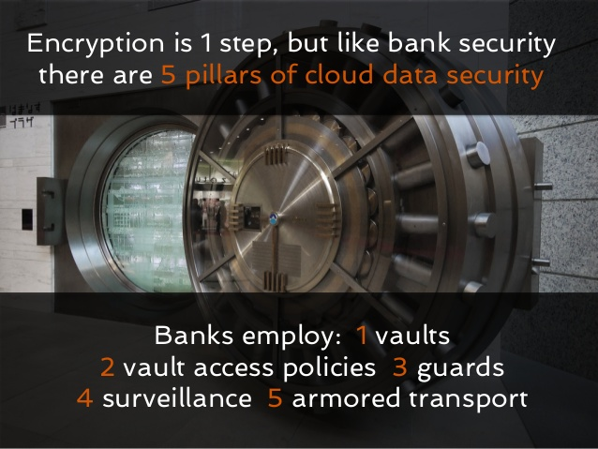

Slide 4
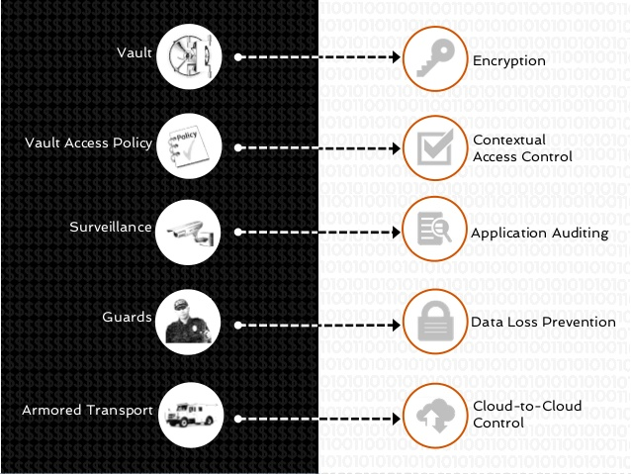
MAPP I NG

Slide 5
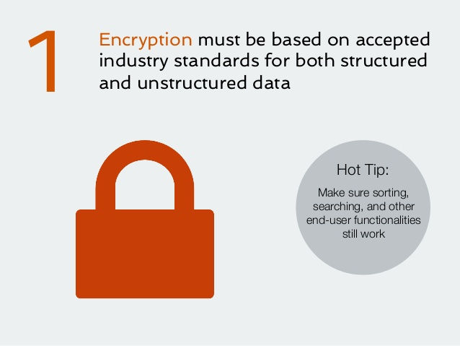

Slide 6
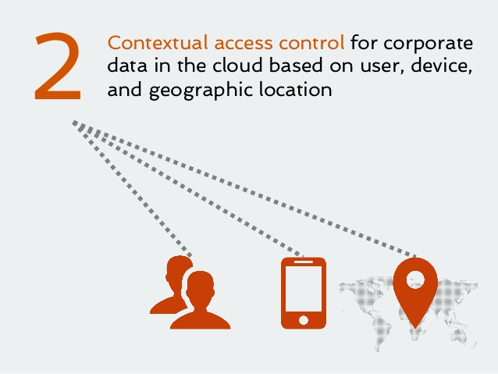

Slide 7
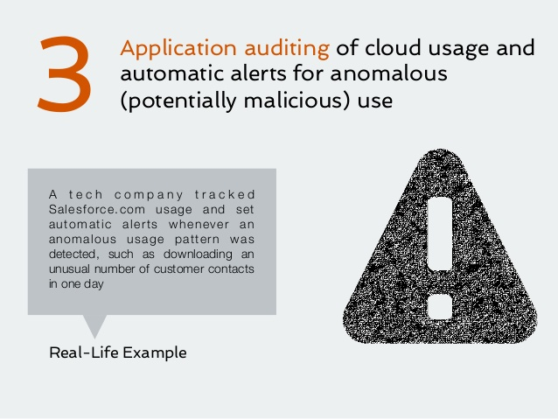

Slide 8
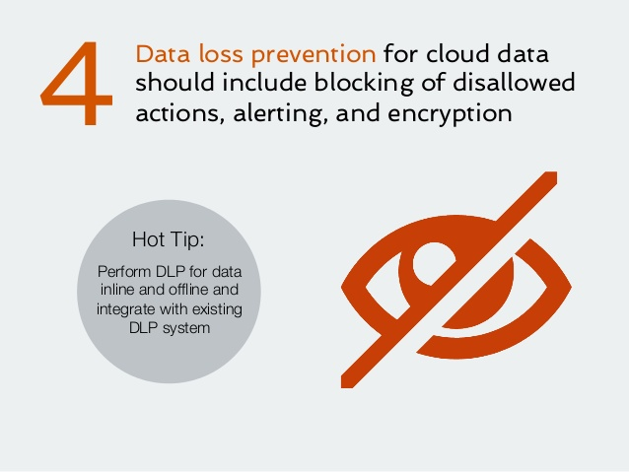

Slide 9
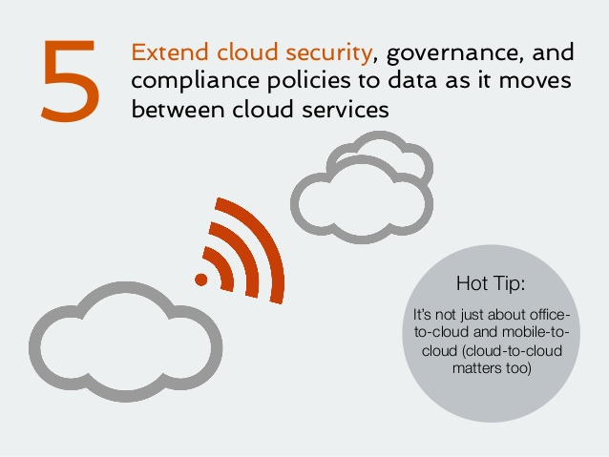

Slide 10
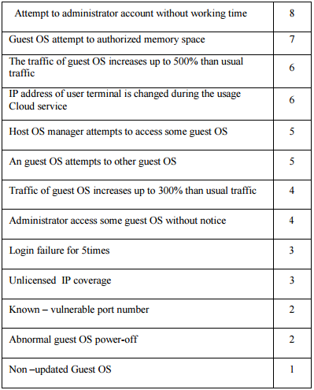
EVALUATION OF USER ANOMALY LEVEL

Slide 11
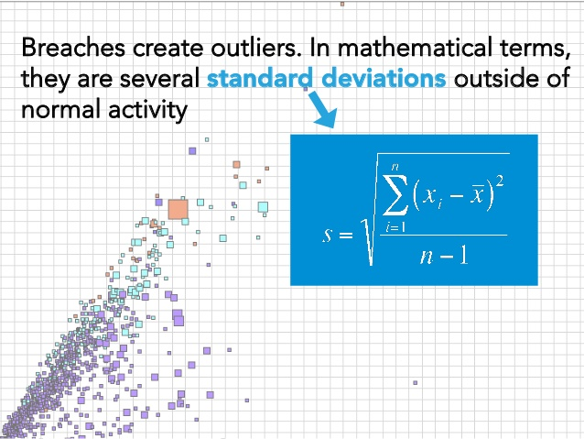

Slide 12
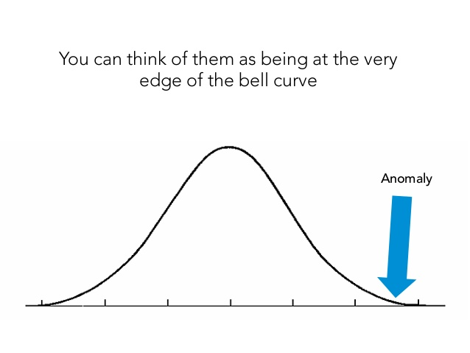

Slide 13
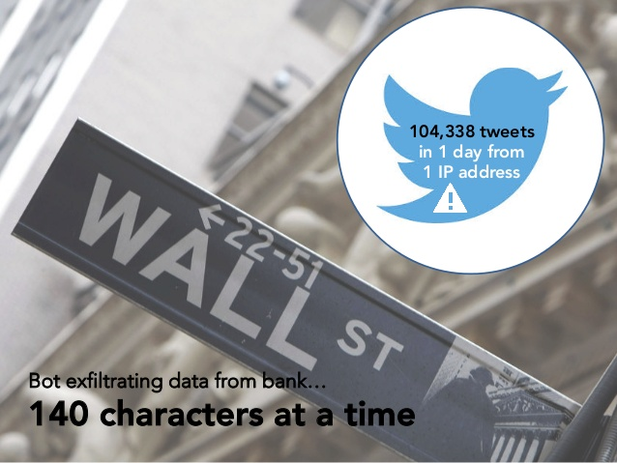
Examples:

Slide 14
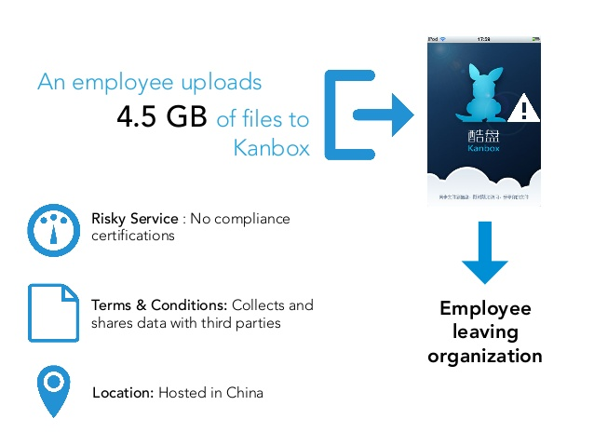

Slide 15


Slide 16
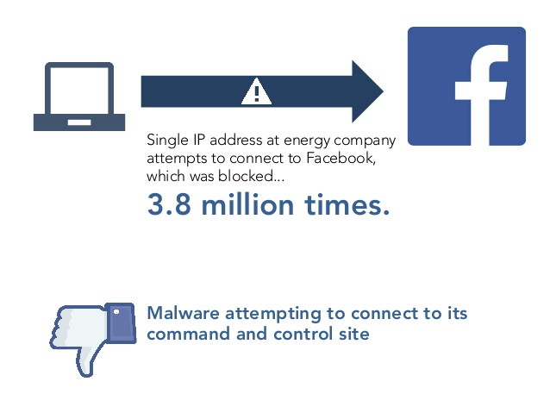

Slide 17
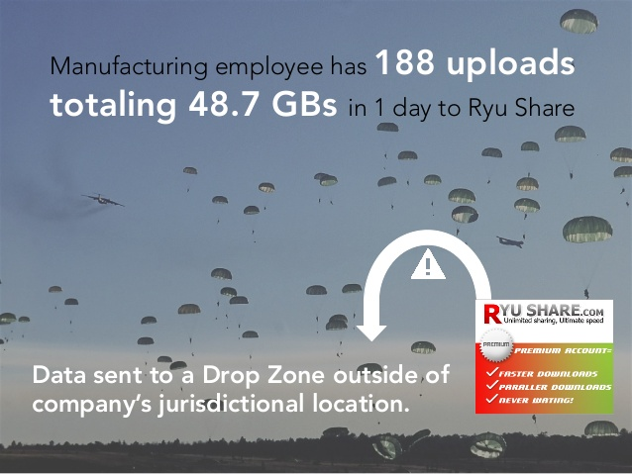

Slide 18
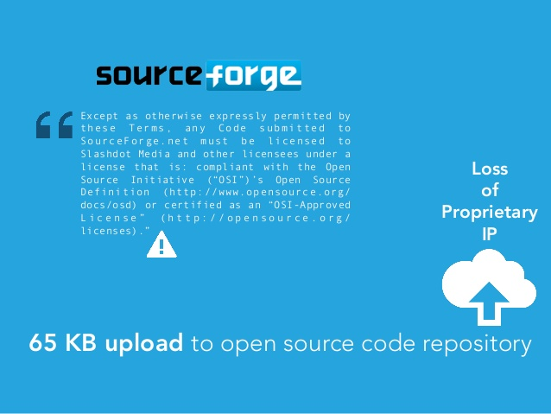

Slide 19
Traditional Systems:
The general detection systems are trained on a large sample of labeled cloud services access. These transactions contain example fraud cases due to lost credentials, stolen authentications, application fraud, etc.
A metaclassifier is thus trained on the correlation of the predictions of the base classifiers.
Using fraud density of real transaction data as a confidence value and generate the weighted fraud score to reduce the number of misdetections.

Slide 20
Problem:
They require labeled data for both genuine, as well as fraudulent transactions, to train the classifiers. Getting real-world fraud data is one of the biggest problems.
Also, these approaches cannot detect new kinds of frauds for which labeled data is not available

Slide 21
Hidden Markov Model
In contrast, a Hidden Markov Model (HMM)-based resource consumption FDS, does not require fraud signatures and yet is able to detect frauds by considering a user’s behavior analysis.
A drastic reduction in the number of False Positives (FPs)—consumptions identified as malicious by an FDS although they are actually genuine.

Slide 22
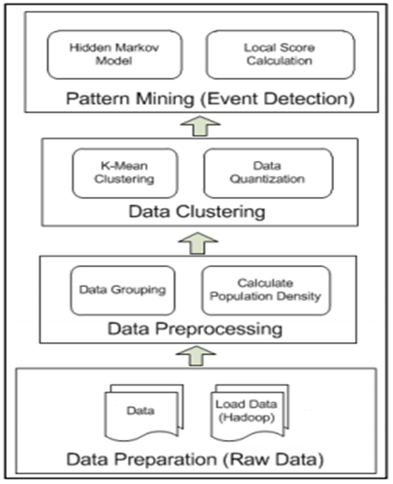
MODEL:

Slide 23
K-means is an unsupervised learning algorithm for grouping a given set of data based on the similarity in their attribute (often called feature) values.
The grouping is performed by minimizing the sum of squares of distances between each data point and the centroid of the cluster to which it belongs.
The centroids or mean values are used to decide the observation symbols when a new data comes in.
The consumption profile of a user suggests his normal resource consumption behavior.
Users are categorized into three groups based on their consumption habits, namely, high-consumption (hc) group, medium-consumption (mc) group, and low-consumption (lc) group.

Slide 24
Probability of generation of the observation sequence O by the HMM
= Σ _{all Q} (Probability that O is generated from a state sequence Q) (Probability of the state sequence Q).
consumption profile -> initial observation probabilities.
state transition probabilities -> uniform.
Let O_{1,} O_{2,} O_{3,} . . . O_{R} be one such sequence whose probability of acceptance by the HMM will be:
₁ = P (O_{1,} O_{2,} O_{3,} . . . O_{R}|λ )
O_{R+1} be the symbol generated by a new transaction at time t+1.
₂ = P (O_{2,} O_{3,} . . . O_{R}, O_{R+1} |λ )

Slide 25
Δ = ₁- ₂
The newly added resource use is determined to be fraudulent if the percentage change in the probability is above a threshold, that is
Δ / ₁ ≥ Threshold.
Order of Selection:
Length of observation symbol sequence -> Threshold -> Number of States

Slide 26
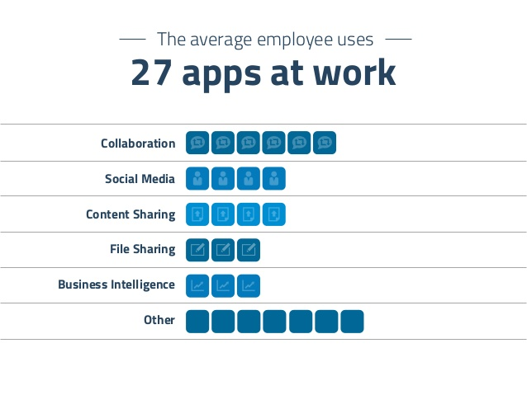
STATISTICS:

Slide 27
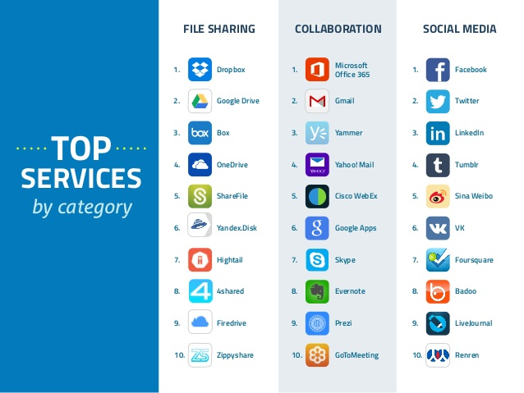

Slide 28
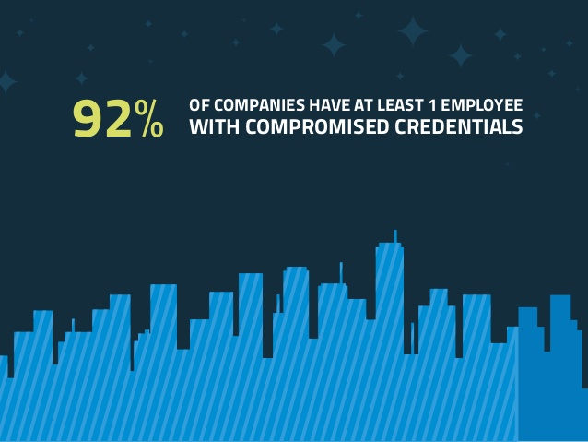

Slide 29
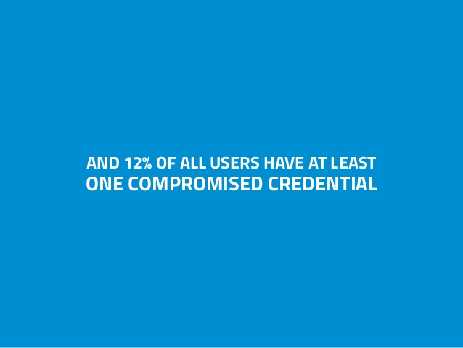

Slide 30


Slide 31
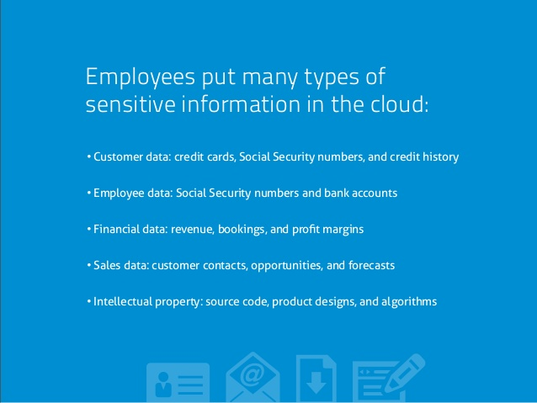

Slide 32
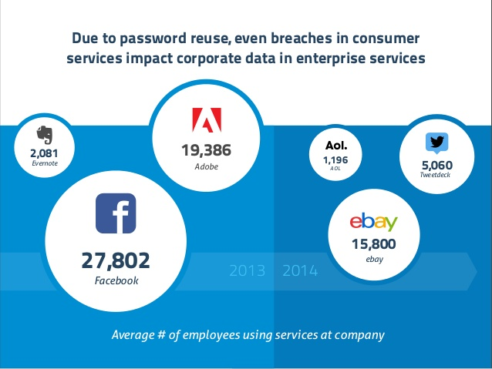

Slide 33
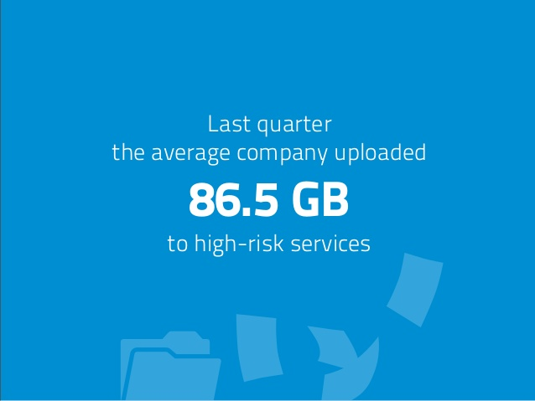

Slide 34
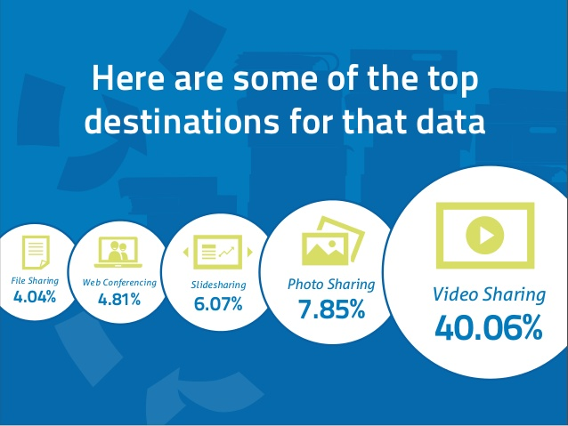

Slide 35


Slide 36
